Slide 1


Data Structure Design I
Chris Piech
CS106A, Stanford University

Slide 2
Interactors

Slide 3
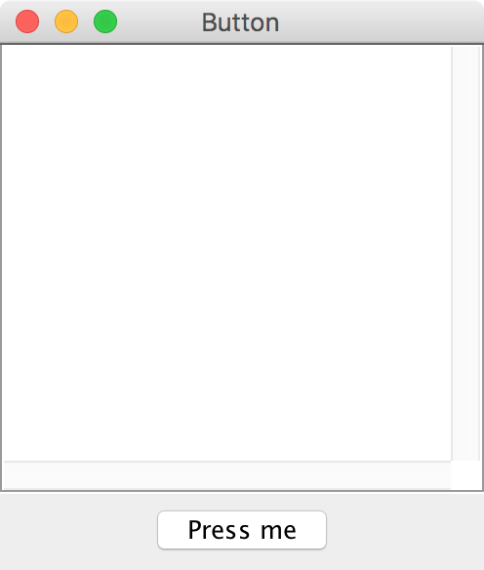
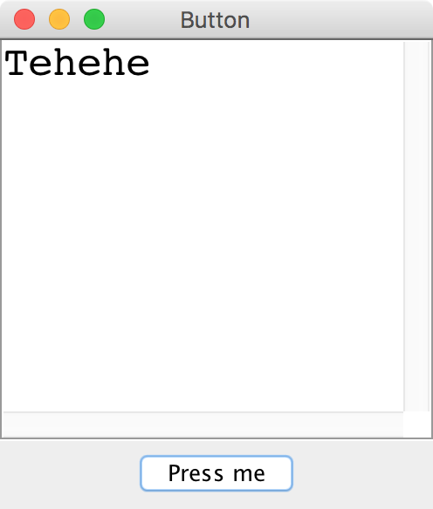
Button

Slide 4
JButton

Slide 5
JButton
JButton button = new JButton("Press me");

Slide 6
JButton
Button Text
JButton button = new JButton("Press me");

Slide 7
JButton
JButton button = new JButton("Press me");
add(button, SOUTH);

Slide 8
JButton
JButton button = new JButton("Press me");
add(button, SOUTH);
addActionListeners();

Slide 9
JButton
public void actionPerformed(ActionEvent e) {
String actionCmd = e.getActionCommand();
if(actionCmd.equals(“Press me”)) {
println(“Tehehe”);
}
}

Slide 10
JButton
public void actionPerformed(ActionEvent e) {
String actionCmd = e.getActionCommand();
if(actionCmd.equals(“Press me”)) {
println(“Tehehe”);
}
}

Slide 11
JButton
public void actionPerformed(ActionEvent e) {
String actionCmd = e.getActionCommand();
if(actionCmd.equals(“Press me”)) {
println(“Tehehe”);
}
}

Slide 12
JButton
public void actionPerformed(ActionEvent e) {
String actionCmd = e.getActionCommand();
if(actionCmd.equals(“Press me”)) {
println(“Tehehe”);
}
}

Slide 13
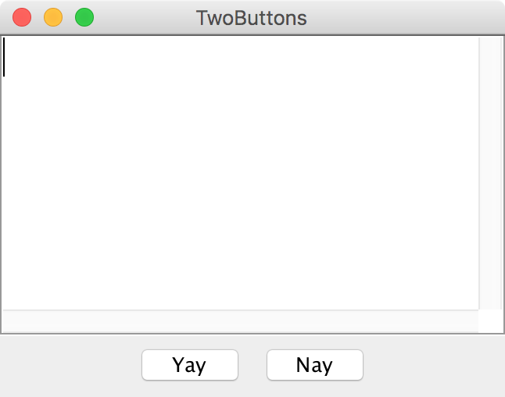
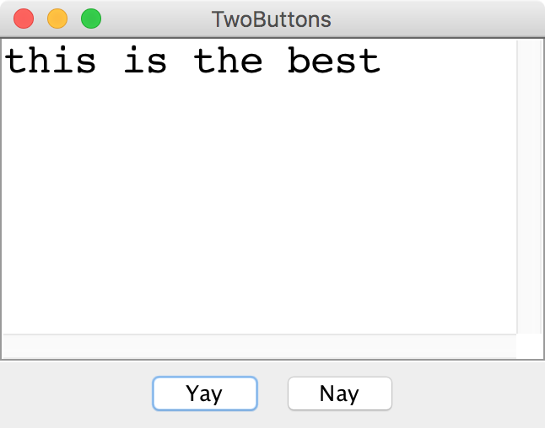
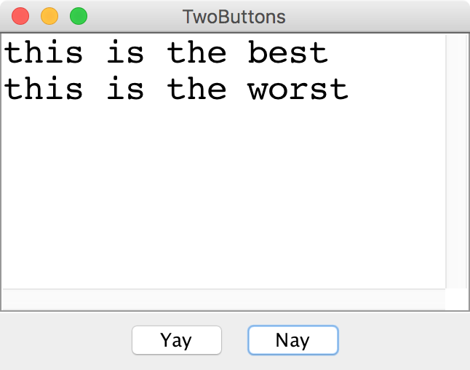
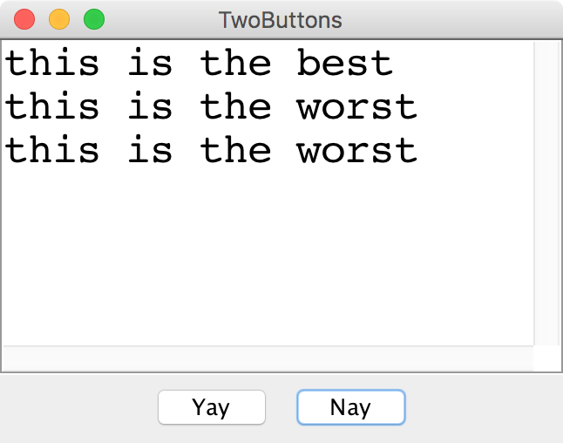
Two Buttons

Slide 14
JLabel

Slide 15
JLabel
JLabel label = new JLabel("Hi");

Slide 16
JLabel
JLabel label = new JLabel("Hi");

Slide 17
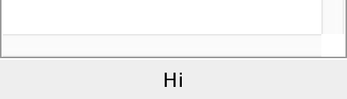
JLabel
JLabel label = new JLabel("Hi");
add(label, SOUTH);

Slide 18
JTextField

Slide 19
JTextField
JTextField field = new JTextField(10);
add(field, SOUTH);
field.getText(); // returns string in field
field.setText("Marry me");

Slide 20
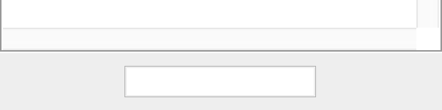
JTextField
JTextField field = new JTextField(10);
add(field, SOUTH);
field.getText(); // returns string in field
field.setText("Marry me");

Slide 21
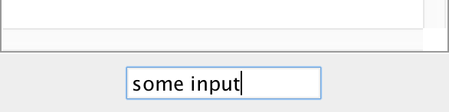
JTextField
JTextField field = new JTextField(10);
add(field, SOUTH);
field.getText(); // returns string in field
field.setText("Marry me");

Slide 22
JTextField
JTextField field = new JTextField(10);
add(field, SOUTH);
field.getText(); // returns “some input”
field.setText("Marry me");

Slide 23
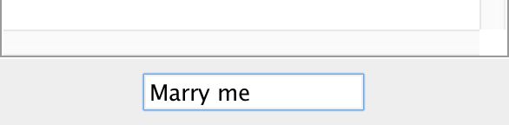
JTextField
JTextField field = new JTextField(10);
add(field, SOUTH);
field.getText(); // returns “some input”
field.setText("Marry me");
*in honor of Carlos, my freshman and sophmore roommate who just proposed

Slide 24
Recall the Dancing Children

Slide 25

Normal Program
Run Method

Slide 26
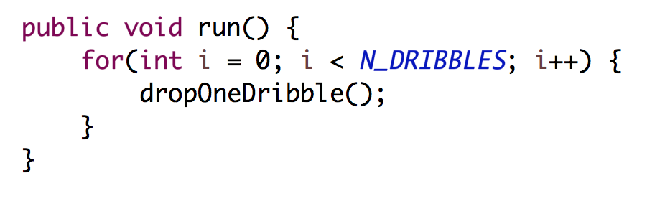
Normal Program
Run Method

Slide 27
Normal Program
Run Method

Slide 28
Normal Program
Run Method

Slide 29

New Listener Characters
Action Listener
Action Performed

Slide 30
Program Starts Running
Run Method
Action Performed

Slide 31
Add Action Listeners
Run Method
Action Performed
Action Listener
addActionListeners();

Slide 32
Program Runs as Usual
Run Method
Action Performed
Action Listener

Slide 33

Button Clicked!
Run Method
Action Performed
Action Listener

Slide 34
Calls Action Performed Method
Run Method
Action Performed
Action Listener

Slide 35
When done, Run continues.
Run Method
Action Performed
Action Listener

Slide 36
Keeps Doing Its Thing…
Run Method
Action Performed
Action Listener

Slide 37
Button Clicked!
Run Method
Action Performed
Action Listener

Slide 38
Calls Action Performed Method
Run Method
Action Performed
Action Listener

Slide 39
When done, Run continues.
Run Method
Action Performed
Action Listener

Slide 40
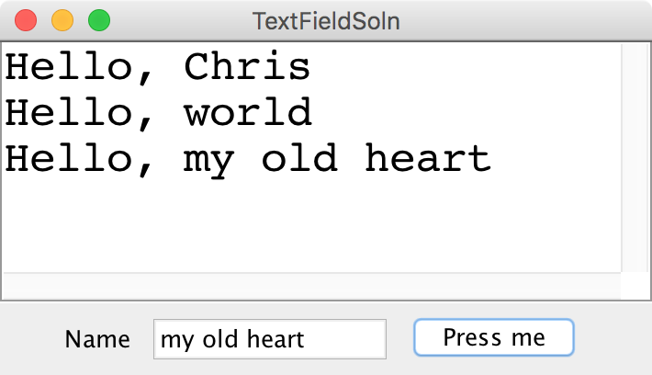
Text Field

Slide 41
Something awesome
*thanks Keith for the idea

Slide 42
Putting two things together

Slide 43

The XKCD Color Survey
Notes:
2/27/17
43
43

Slide 44
Notes:
2/27/17
44
44

Slide 45
Notes:
2/27/17
45
45

Slide 46
Notes:
2/27/17
46
46

Slide 47
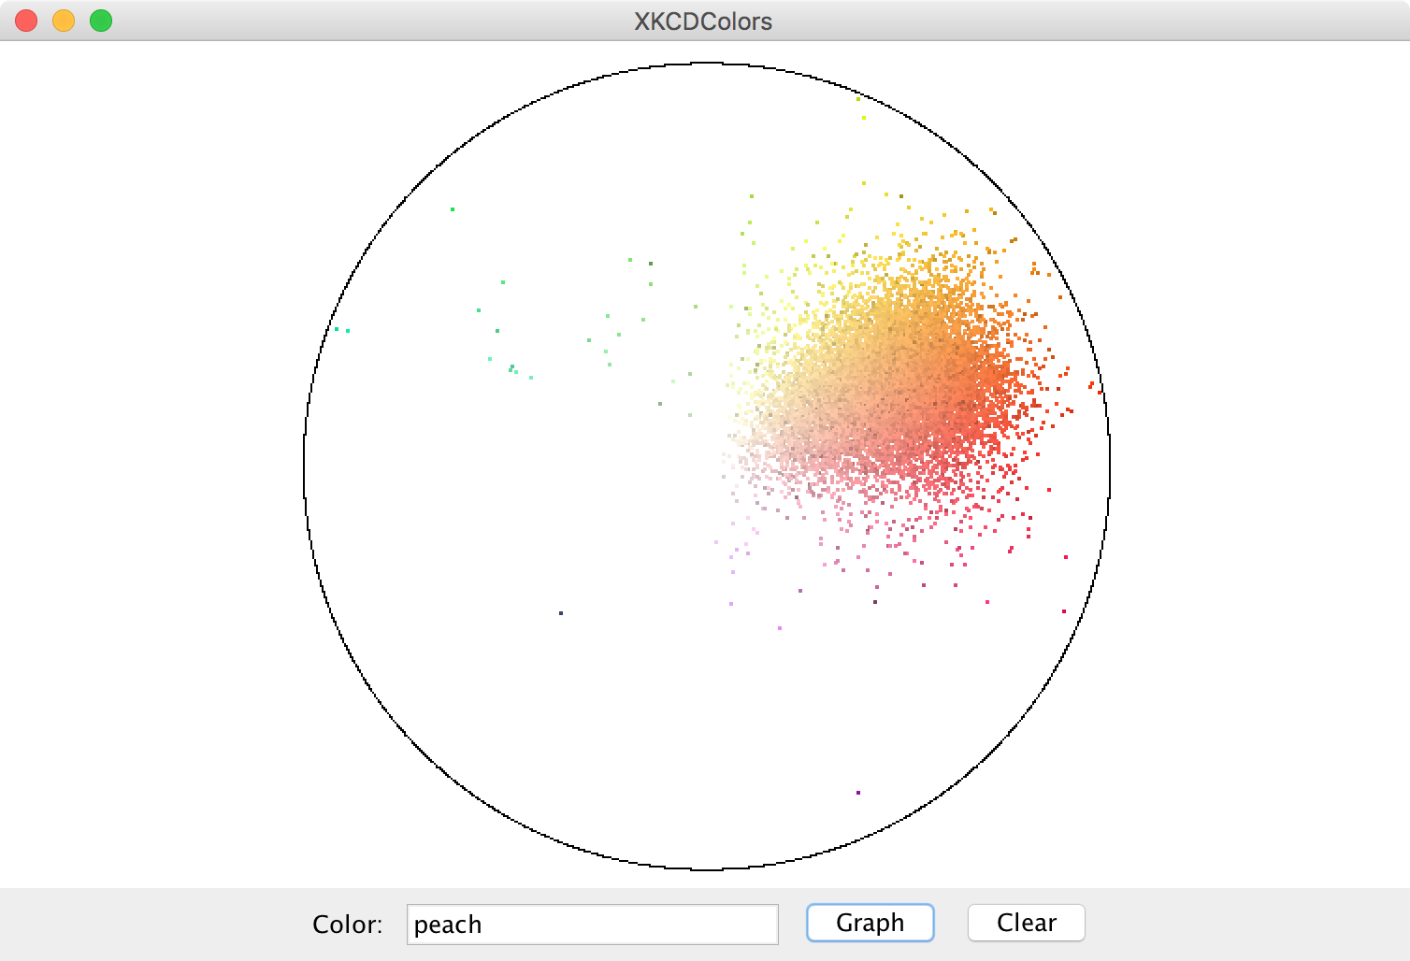

Slide 48
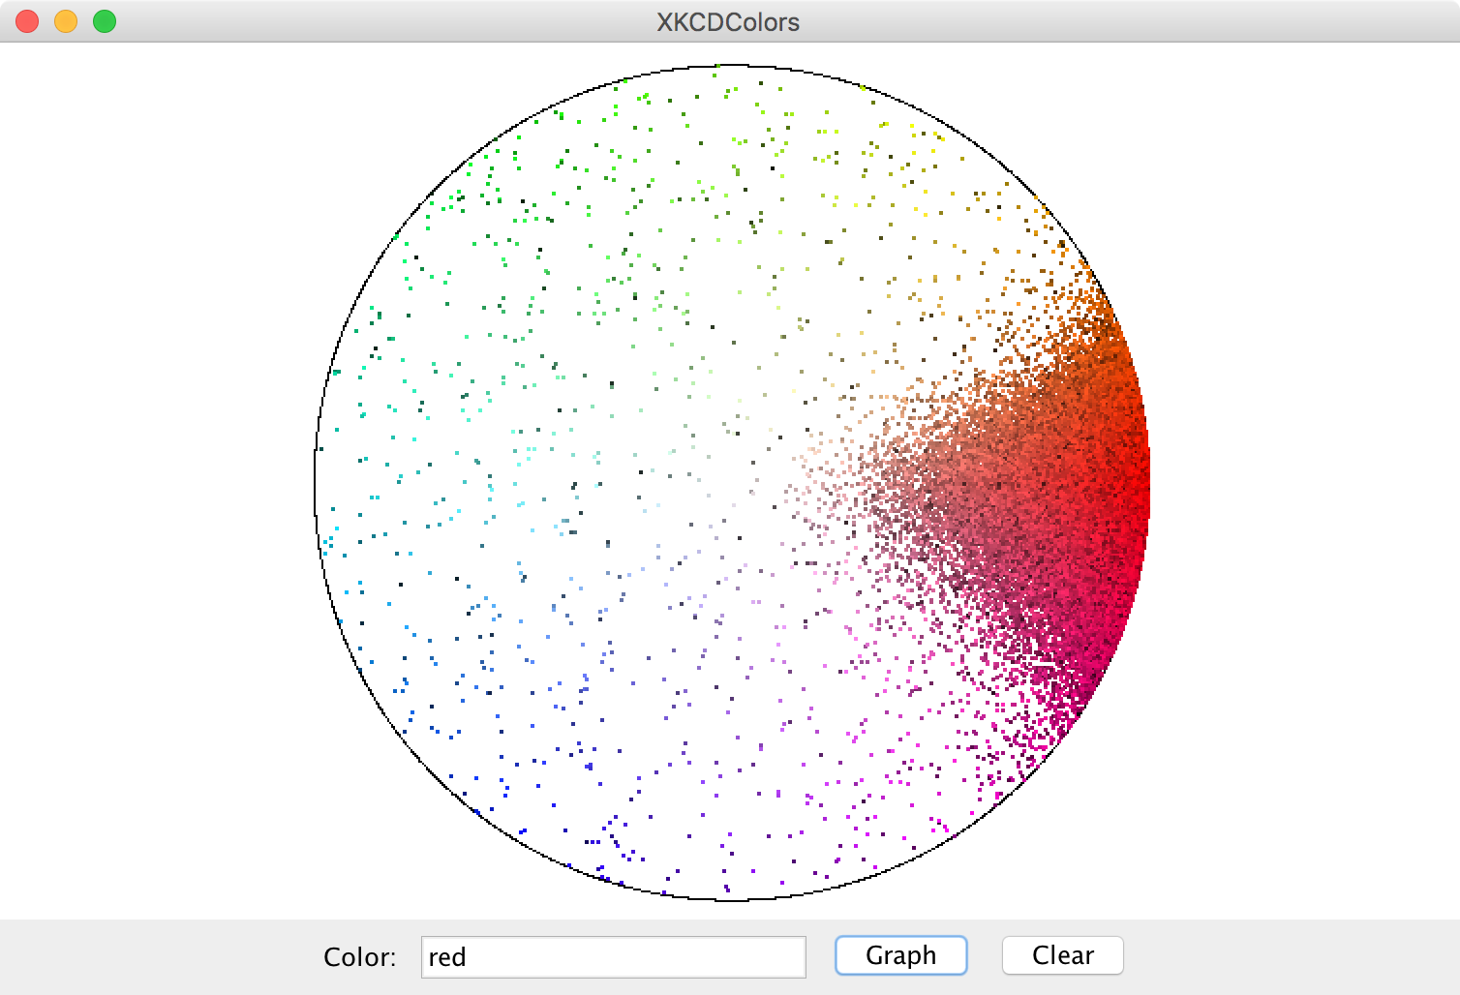

Slide 49
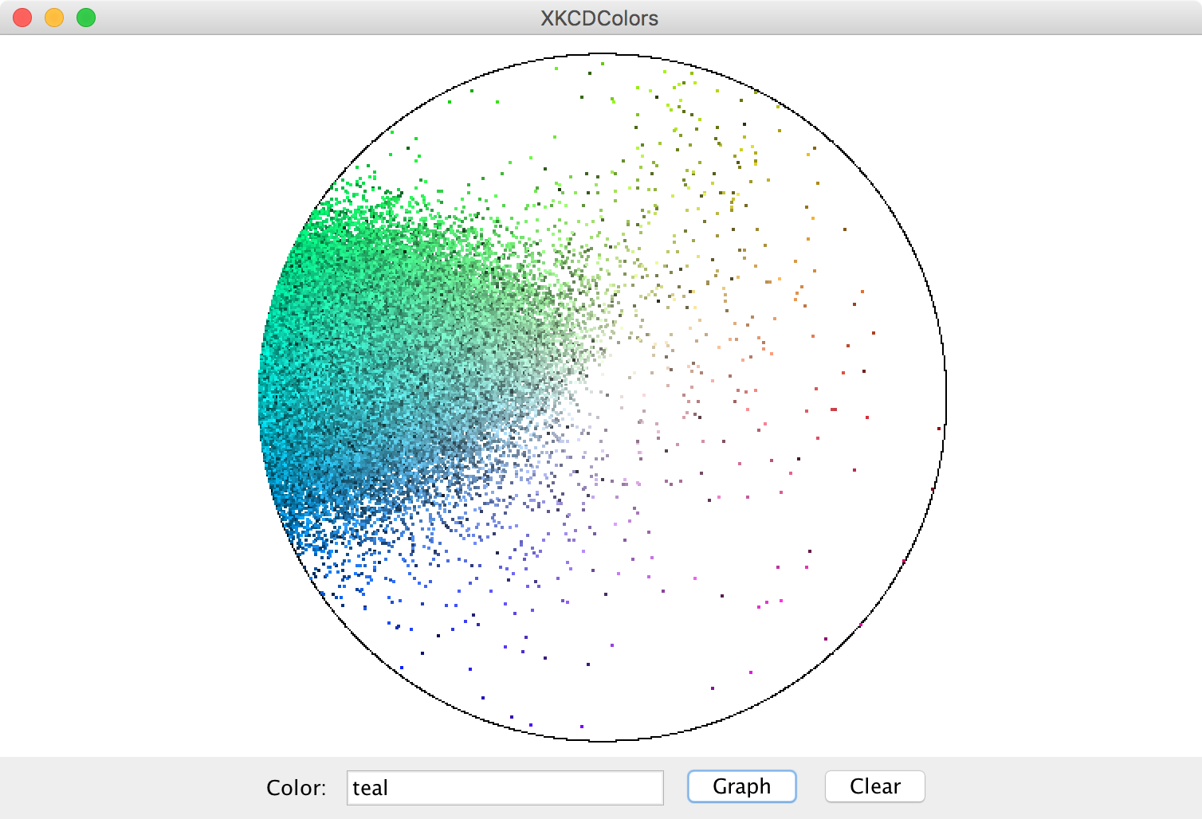

Slide 50
The XKCD Color Survey
Volunteers (online) were shown a randomly-chosen color and asked to name the color.
The result is (after filtering) about 2.8 million RGB triplets and their names.
Notes:
2/27/17
50
50

Slide 51
The File Format
color-name,
red,
green,
blue
Notes:
2/27/17
51
51

Slide 52
How to Structure Data
blue
15
137
255
0
0
127
88
88
190
red
166
14
7
99
55
5
255
0
0
gray
154
156
157
243
242
254
140
143
148
associate each color name
with a list of colors
Notes:
2/27/17
52
52

Slide 53
How to Structure Data
blue
15
137
255
0
0
127
88
88
190
red
166
14
7
99
55
5
255
0
0
gray
154
156
157
243
242
254
140
143
148
HashMap<color name, list of colors>
Notes:
2/27/17
53
53

Slide 54
How to Structure Data
blue
15
137
255
0
0
127
88
88
190
red
166
14
7
99
55
5
255
0
0
gray
154
156
157
243
242
254
140
143
148
HashMap<String, list of colors>
Notes:
2/27/17
54
54

Slide 55
How to Structure Data
blue
15
137
255
0
0
127
88
88
190
red
166
14
7
99
55
5
255
0
0
gray
154
156
157
243
242
254
140
143
148
HashMap<String, ArrayList<color>>
Notes:
2/27/17
55
55

Slide 56
How to Structure Data
blue
15
137
255
0
0
127
88
88
190
red
166
14
7
99
55
5
255
0
0
gray
154
156
157
243
242
254
140
143
148
BHashMap<String, ArrayList<Color>>B
Notes:
2/27/17
56
56

Slide 57
Further Reading
http://blog.xkcd.com/2010/05/03/color-survey-results/
Notes:
2/27/17
57
57

Slide 58
pause(1000);

Slide 59
Some large programs are in Java

Slide 62
How?

Slide 63
Define New Variable Types
Email Sender
Login Manager
Inbox Database
Email
Inbox
User

Slide 64
Even small programs
define new variable types

Slide 65
Can you do this?

Slide 66
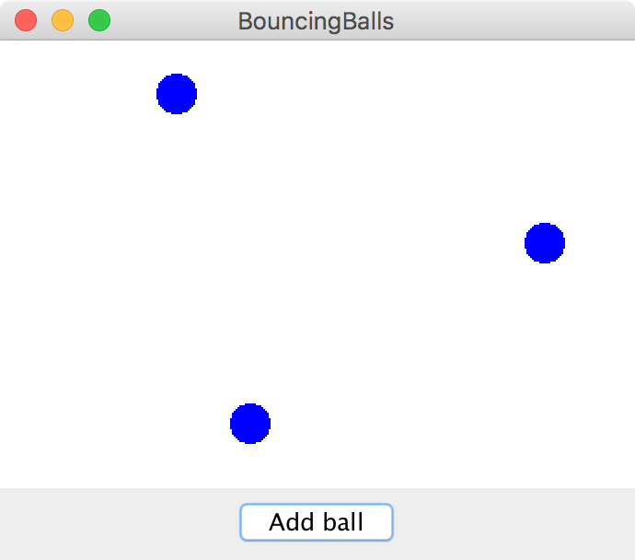
Bouncing Balls

Slide 67


Classes define new Variable Types
A student registration system needs to store info about students, but Java has no Student type.
A music synthesizer app might want to store information about users' accounts, but Java has no Instrument type.
However, Java does provide a feature for us to add new data types to the language: classes.
Writing a class defines a new data type.

Slide 68


Classes are like blueprints
class: A template for a new type of variable.
A blueprint is a helpful analogy

Slide 69
#key: Classes define new variable types

Slide 70
#key: Classes decompose your program across files

Slide 71
Classes are like blueprints
To design a new variable type you must specify three things:
What subvariables make up this new variable type?
What methods can you call on a variable of this type?
What happens when you make a new instance of this type?

Slide 72
What is a class?

Slide 73
A class defines a new variable type

Slide 74
Kenya has used mobile banking for 10 years

Slide 75
Classes: Take 1
This goes in BankAccount.java!
public class BankAccount {
// the instance variables define what makes up the class
public String name;
public double money;
}
Instance variables have a special meaning

Slide 76
Classes: Take 1
public class BankAccount {
// the instance variable define what makes up the class
public String name;
public double money;
}
public class Benmo{
public void run() {
BankAccount chris = new BankAccount();
BankAccount nick = new BankAccount();
chris.name = “Chris”;
chris.money = 100;
nick.name = “Nick”;
nick.money = 50;
}
}

Slide 77
Classes: Take 1
public class BankAccount {
// the instance variable define what makes up the class
public String name;
public double money;
}
public class Benmo{
public void run() {
BankAccount chris = new BankAccount();
BankAccount nick = new BankAccount();
chris.name = “Chris”;
chris.money = 100;
nick.name = “Nick”;
nick.money = 50;
}
}
run
name
chris
money
nick

Slide 78
Classes: Take 1
public class BankAccount {
// the instance variable define what makes up the class
public String name;
public double money;
}
public class Benmo{
public void run() {
BankAccount chris = new BankAccount();
BankAccount nick = new BankAccount();
chris.name = “Chris”;
chris.money = 100;
nick.name = “Nick”;
nick.money = 50;
}
}
run
name
chris
money
name
nick
money

Slide 79
Classes: Take 1
public class BankAccount {
// the instance variable define what makes up the class
public String name;
public double money;
}
public class Benmo{
public void run() {
BankAccount chris = new BankAccount();
BankAccount nick = new BankAccount();
chris.name = “Chris”;
chris.money = 100;
nick.name = “Nick”;
nick.money = 50;
}
}
run
name
“Chris”
chris
money
name
nick
money

Slide 80
Classes: Take 1
public class BankAccount {
// the instance variable define what makes up the class
public String name;
public double money;
}
public class Benmo{
public void run() {
BankAccount chris = new BankAccount();
BankAccount nick = new BankAccount();
chris.name = “Chris”;
chris.money = 100;
nick.name = “Nick”;
nick.money = 50;
}
}
run
name
“Chris”
chris
money
100.0
name
nick
money

Slide 81
Classes: Take 1
public class BankAccount {
// the instance variable define what makes up the class
public String name;
public double money;
}
public class Benmo{
public void run() {
BankAccount chris = new BankAccount();
BankAccount nick = new BankAccount();
chris.name = “Chris”;
chris.money = 100;
nick.name = “Nick”;
nick.money = 50;
}
}
run
name
“Chris”
chris
money
100.0
name
“Nick”
nick
money

Slide 82
Classes: Take 1
public class BankAccount {
// the instance variable define what makes up the class
public String name;
public double money;
}
public class Benmo{
public void run() {
BankAccount chris = new BankAccount();
BankAccount nick = new BankAccount();
chris.name = “Chris”;
chris.money = 100;
nick.name = “Nick”;
nick.money = 50;
}
}
run
name
“Chris”
chris
money
100.0
name
“Nick”
nick
money
50.0

Slide 83
What is a class?

Slide 84
A class defines a new variable type

Slide 85
withdraw
Bank account data
run
deposit
Wall of abstraction

Slide 86
Adding Privacy
private double money;
encapsulation: Hiding implementation details of an object from its clients.
Encapsulation provides abstraction.
separates external view (behavior) from internal view (state)
Encapsulation protects the integrity of an object's data.
A class's instance variables should be declared private.
No code outside the class can access or change it.

Slide 87
Classes: Take 2
This goes in its own file!
public class BankAccount {
// the instance variable define what makes up the class
public String name;
public double money;
}
Instance variables have a special meaning
Each bank account has a _________

Slide 88
Classes: Take 2
public class BankAccount {
// 1. What variables make up the class
public String name;
public double money;
}

Slide 89
Classes: Take 2
public class BankAccount {
// 1. What variables make up the class
private String name;
private double money;
}

Slide 90
Classes: Take 2
public class BankAccount {
// 1. What variables make up the class
private String name;
private double money;
// 2. What methods can a user call on a bankAccount?
public void deposit(double amount) {
...
}
public boolean withdraw(double amount) {
...
}
}

Slide 91
Classes: Take 2
public class BankAccount {
// 1. What variables make up the class
private String name;
private double money;
// 2. What methods can a user call on a bankAccount?
public void deposit(double amount) {
this.money += amount;
}
public boolean withdraw(double amount) {
...
}
}

Slide 92
this

Slide 93
Classes: Take 2
public class BankAccount {
// 1. What variables make up the class
private String name;
private double money;
// 2. What methods can a user call on a bankAccount?
public void deposit(double amount) {
this.money += amount;
}
public boolean withdraw(double amount) {
...
}
}

Slide 94
Classes: Take 2
public class BankAccount {
// 1. What variables make up the class
private String name;
private double money;
// 2. What methods can a user call on a bankAccount?
public void deposit(double amount) {
this.money += amount;
}
public boolean withdraw(double amount) {
if(amount <= this.money) {
this.money -= amount;
return true;
}
return false;
}
}

Slide 95
Classes: Take 2
public class BankAccount {
// 1. What variables make up the class
private String name;
private double money;
// 2. What methods can a user call on a bankAccount?
public void deposit(double amount) {
this.money += amount;
}
public boolean withdraw(double amount) {
if(amount <= this.money) {
this.money -= amount;
return true;
}
return false;
}
// 3. How do you make a new one?
public BankAccount(String name, double amount) {
this.money = amount;
this.money = name;
}
}

Slide 97
Classes on one slide
1. What variables make up this new super variable type?
Instance variables
2. What methods can you call on a variable of this type?
It’s public methods
3. What happens when the user makes a new instance?
The “constructor”
* Don’t forget that all methods and constructors have access to a this reference

Slide 98
What classes?

Slide 99
What is a class?

Slide 100
A class defines a new variable type

